Slide 1

Atliq mart fmgc analysis
Project Done by: Patil Prashanth kumar
https://www.novypro.com/project/atilq-mart-fmgc-analysis

Slide 2




About me
This is Prashanth Patil
I am an enthusiastic Data Analyst with over 5 years of industry experience.
Specialized in Data Driven solutions and transforming insights into actionable strategies
For this project, I have used different tools:
Microsoft SQL Server
Power Bi for Data Visualization
Python for Data ETL

Slide 3





THE PROBLEM
Company
Promotions
Analysis
Ad-hoc Requests
Dashboard
AtliQ Mart is a giant retailer with over 50 supermarkets in southern region of India
Ran a massive promotion during the Diwali 2023 and Sankranti 2024 on their AtilQ branded products
Sales Director wants to understand which products did well and which are not to take informed decisions
Business required to get some Ad-hoc requests to be implement in SQL Server
Required a details Dashboard of the insights gained from the Metadata provided by the AtliQ

Slide 4

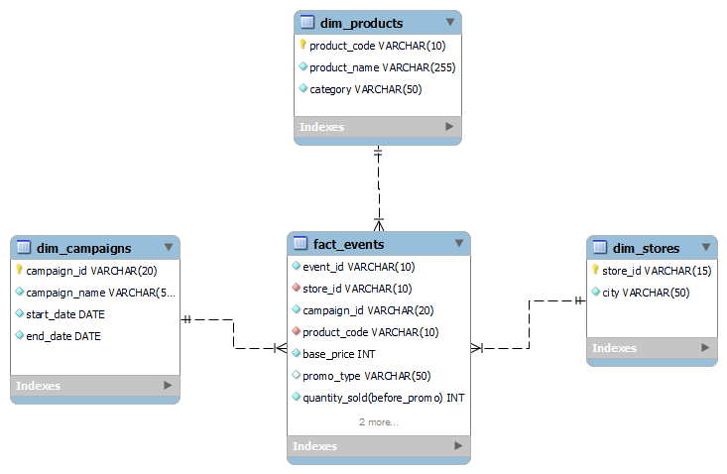
Slide 10
METADATA
The data contains:
Fact Table:
fact_events
Dim Tables:
dim_campaigns
Dim_products
dim_stores

Slide 5

KEY METRICS USED
ISU – Incremental Sold Units
Incremental Sold unit is the difference of Quantity sold before and after promotion
IR – Incremental Revenue
Incremental Revenue is the difference of the Revenue before and after promotion
Promotions
Percentage Discount
BOGOF(Buy One Get One Free)
Cashback

Slide 6


AD-HOC REQUESTS
List of Products with a base price greater than 500 featured in BOGOF promo type
Overview of number of stores in each city
Each campaign with total revenue generated before and after the campaign
Calculate ISU% for each category during Diwali Campaign
Top 5 products ranked by IR% across all campaigns

Slide 7

Slide 1
Ad-Hoc Insights

Slide 8

Request 1
LIST OF PRODUCTS WITH A BASE PRICE GREATER THAN 500 and FEATURED IN PROMO "BOGOF"
QUERY:
SELECT DISTINCT(p.product_name), e.base_price, e.promo_type FROM dim_products p RIGHT JOIN fact_events eON p.product_code = e.product_codeWHERE e.base_price>500 AND e.promo_type LIKE '%BOGOF%'
OUTPUT:

Slide 9
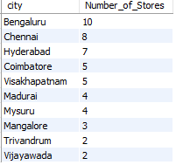
Request 2
LIST OF NUMBER OF STORES IN EACH CITY WITH DESCENCING ORDER
QUERY:
SELECT city, COUNT(store_id) as Number_of_Stores FROM dim_stores GROUP BY city ORDER BY Number_of_Stores DESC
OUTPUT:
Highest number of stores is in Bengaluru. Whereas the least are in Trivandrum and Vijayawada cities

Slide 10

Request 3
REPORT THAT GENERATES EACH CAMPAIGN ALONG WITH TOTAL REVENUE GENERATED BEFORE AND AFTER PROMOTION
QUERY:
SELECT campaign_id, ROUND(SUM(Revenue_BeforePromo)/1000000,2) as Revenue_Before_Promo_in_Mil,ROUND(SUM(Revenue_AfterPromo)/1000000,2) as Revenue_After_Promo_in_Mil FROM fact_eventsGROUP BY campaign_id
OUTPUT:
Campaign CAMP_DIW_01 has highest revenue before and after promotion applied

Slide 11
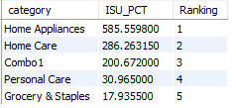
Request 4
CALCULATE INCREMENTAL SOLD QUANTITY (ISU) % FOR EACH CATEGORY IN DIWALI CAMPAIGN
QUERY:
WITH CTE1 AS (
SELECT p.category, AVG(ROUND((fe.ISU/fe.`quantity_sold(before_promo)`)*100,2)) as ISU_PCTFROM dim_products p JOIN fact_events fe ON p.product_code = fe.product_code WHERE fe.campaign_id = 'CAMP_DIW_01' GROUP BY p.category
) SELECT *, RANK() OVER(ORDER BY ISU_PCT DESC) as Ranking FROM CTE1
OUTPUT:
Home Appliances category has the highest Incremental Sold Units.

Slide 12
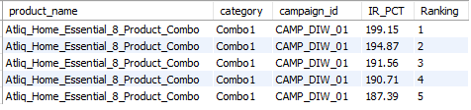
Request 5
FEATURE TOP 5 PRODUCTS RANKED BY INCREMENTAL REVENUE PERCENTAGE ACROSS ALL CAMPAIGNS
QUERY:
WITH CTE1 AS (
SELECT p.product_name, p.category, fe.campaign_id, ROUND((fe.IR/fe.Revenue_BeforePromo)*100,2) as IR_PCT FROM dim_products p JOIN fact_events fe ON p.product_code = fe.product_code
) SELECT *, ROW_NUMBER() OVER (ORDER BY IR_PCT DESC) as Ranking FROM CTE1 LIMIT 5

Slide 13
Slide 1
Dashboard Insights
Live Dashboard:
https://app.powerbi.com/view?r=eyJrIjoiYTEyZTg1MWQtOTVlZS00NDAzLThmNWItNDExODkxMTU2M2FmIiwidCI6ImM2ZTU0OWIzLTVmNDUtNDAzMi1hYWU5LWQ0MjQ0ZGM1YjJjNCJ9

Slide 14
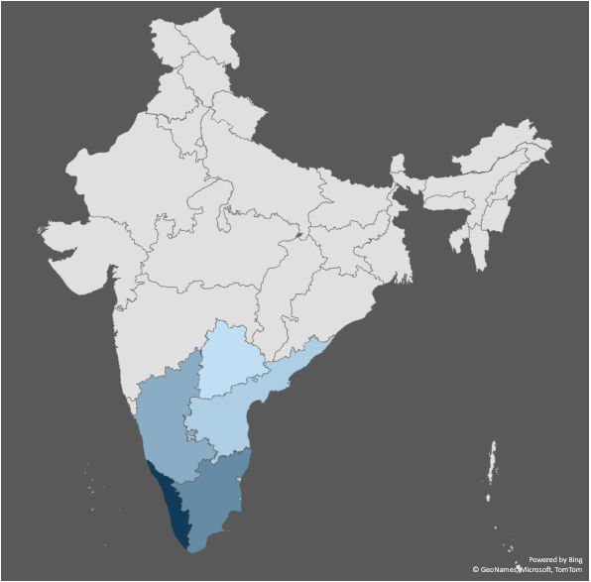
AtliQ Mart Stores Operated Cities
Cities | Number of Stores
Bengaluru, India | 10
Chennai, India | 8
Coimbatore, India | 5
Hyderabad, India | 7
Madurai, India | 4
Mangalore, India | 3
Mysuru, India | 4
Trivandrum, India | 2
Vijayawada, India | 2
Visakhapatnam, India | 5

Slide 15






Key Measures
155M
442K
Promotions Type
25% OFF
33% OFF
50% OFF
500 Cashback
BOGOF (Buy One Get One Free)
Incremental Revenue
Incremental Sold Units
296M
141M
Revenue After Promo
Revenue Before Promo
15
5
Total Products in AtliQ Mart
Total Categories
209K
651K
Quantity Sold Before Promo
Quantity Sold After Promo

Slide 16
Top 10 and Bottom 10 Stores in IR

Slide 19
Incremental Revenue of All Products
Product Names | Incremental Revenue
Atliq_Home_Essential_8_Product_Combo | 91.05M
Atliq_waterproof_Immersion_Rod | 17.56M
Atliq_Farm_Chakki_Atta (1KG) | 17.36M
Atliq_Double_Bedsheet_set | 12.92M
Atliq_Suflower_Oil (1L) | 8.19M
Atliq_High_Glo_15W_LED_Bulb | 7.59M
Atliq_Curtains | 3.52M
Atliq_Scrub_Sponge_For_Dishwash | -.11M
Atliq_Cream_Beauty_Bathing_Soap (125GM) | -.14M
Atliq_Lime_Cool_Bathing_Bar (125GM) | -.16M
Atliq_Masoor_Dal (1KG) | -.18M
Atliq_Body_Milk_Nourishing_Lotion (120ML) | -.22M
Atliq_Doodh_Kesar_Body_Lotion (200ML) | -.33M
Atliq_Fusion_Container_Set_of_3 | -.77M
Atliq_Sonamasuri_Rice (10KG) | -1.39M

Slide 20
Insights
The expansion strategy should prioritize all cities, with particular attention given to scaling up store presence in key locations such as Vijayawada and Trivandrum
the Grocery and Staples Category experienced the most significant surge in sales following promotional activities, indicating a need to redirect focus towards underperforming categories such as Personal Care and Home Care.
Bengaluru stands out with the highest Incremental Revenue attributed to its extensive network of operational stores.
the Sankranti Campaign outperformed the Diwali Campaign in generating revenue, suggesting potential adjustments in seasonal marketing strategies.

Slide 21

Thank you !
https://www.linkedin.com/in/prashanthpatil1/
https://www.novypro.com/project/atilq-mart-fmgc-analysis

